Slide 1
Physics at UW-Stout
Dual degree in engineering and physics
ASAP-ME:
Applied Science: Applied Physics and Mechanical Engineering Double Major
Why get a dual degree?
Gain additional skills to compliment engineering
Stand out in the crowd of engineering majors
Learn more about how the laws of physics work
Have fun!
Scan QR Code to see flowchart
Additional Courses:
Intro to Physics Research
Intro to Quantum Mechanics
Computational Classical Physics
Solid State Physics
Applied Optics and Photonics
Advanced Physics Lab
Quantum Mechanics
Applied Electromagnetics
Computer Science I and II
Contact Prof. Zimmerman if you’d like me to put together a sample graduation plan for you:
zimmermant@uwstout.edu
Lasers, Optics, Plasmas, Computational Modeling, and Quantum Computers

Slide 2
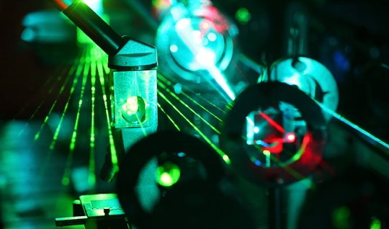
Physics Minor
Statics and Dynamics or University Physics I
University Physics II
11 credits from the following:
PHYS-139 Intro to Research
CEE-355 Applied E&M
Any PHYS-3XX
Thermodynamics (PHYS-222 or ENGR-275 or ME-390)
Classes in bold are ones you take for your major
Contact Prof. Sinkovits for information: sinkovitsd@uwstout.edu
Notes:
CEE-355 also counts

Slide 3



Applied Optics and Photonics (PHYS-335)
Counts as a Tech Elective for some engineering majors
Bottle illuminated with an industrial laser beam by Dylan O’Donnel 12/28/14
The questions answered in this class include:
What is light and how can it be both a wave and a particle?
How can light be made to interfere with itself and then used to make measurements?
How can lenses and other optical elements be used to control light?
How do optical fibers work?
How lasers work and what sort of amazing things you can do with them?
How we know that phasers and Star Wars blasters can’t be lasers?
What does Fourier analysis have to do with diffraction and propagation of light?
Fall 2023
MWF
3:35-4:30 pm

Slide 4
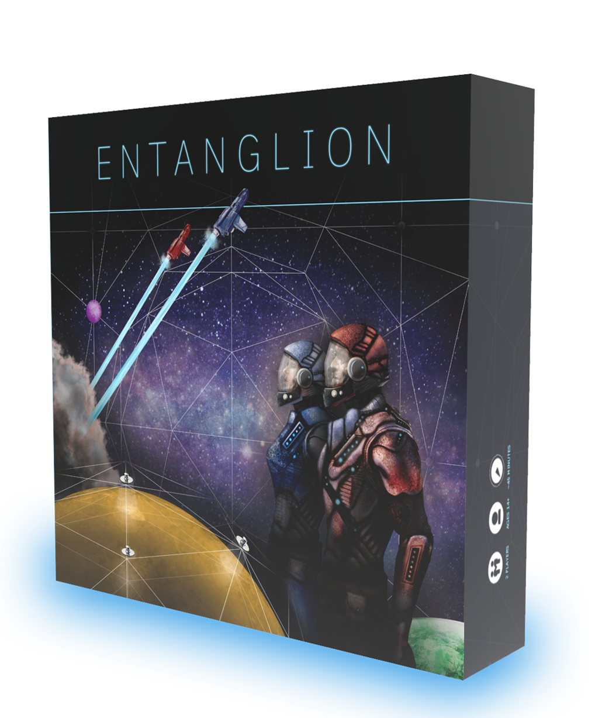

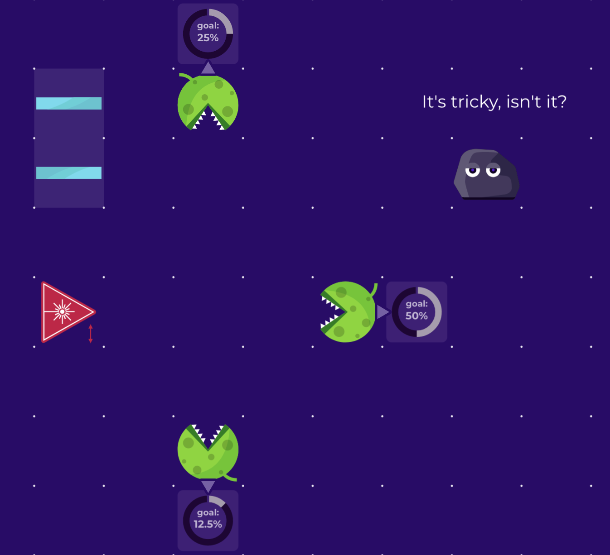
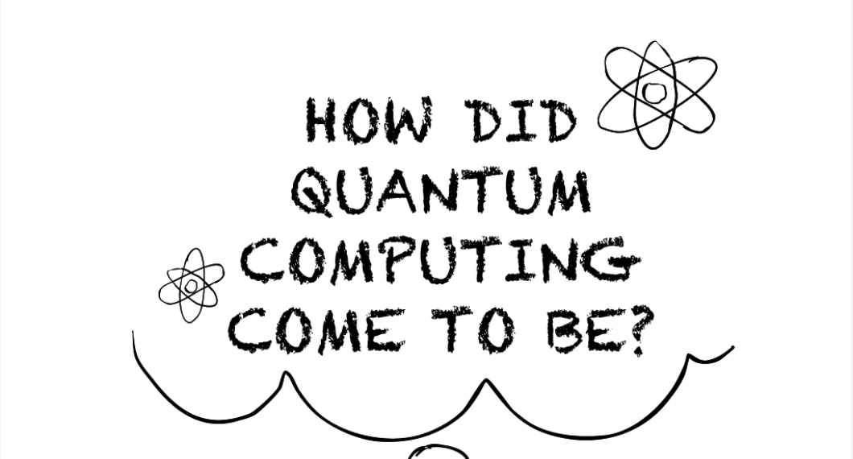
PHYS-113 Quantum Revolution for Everyone FA 23, Tu/Th 11:15-12:10 (class), F 11:15-1:15 (lab) Gen Ed: ARNS with lab (3 cr), pre-req(s): none
Explore the quantum realm through board games, computer games, and other hands-on activities.
Learn about:
Quantum computers
How data is hacked
Safekeeping secrets
Quantum sensors

